Slide 1
STUDENT RESULT SYSTEM
Presented By:
25B11AI908 Pasupuleti Sai
25B11AI745 MANNEPALLY MARUTHI NAGA SAI SRINIVAS
25B11AIC03 THOTAKURI REVANTH
26B21AI099 PASUPULETI VENKATA SURYA HARSHA
Course Instructor:
N.AKHILA, M.Tech(Ph.D),
ASSISTANT PROFESSOR,
AIML DEPARTMENT

Slide 2
Contents
Project Abstract
Problem Statement & Objectives
Planned Modules / Functions
Users of the system
Modules/Functionalities
Architecture Diagram
ER Diagram / DFD
Planning and Timeline Diagram
Role of each individual

Slide 3
Project Abstract
The Student Result System is a C++ project that helps manage student academic results easily. It stores student details, calculates total marks, average, percentage, and grade automatically. The system reduces manual work and errors by using object-oriented concepts like classes and functions. It provides a simple menu interface to add, search, and display student results efficiently.

Slide 4
Problem Statement & Objectives
Problem Statement
Manual result management requires considerable time for calculating marks, assigning grades and identifying student performance. It may also result in calculation and record-management errors.
Objectives
Develop a simple Student Result Management System using C++.
Store student information using classes and objects.
Calculate total, average and percentage automatically.
Generate grades and Pass/Fail status.
Provide student search functionality.
Identify topper(s).
Display all failed students.
Implement input validation and duplicate roll-number checking.

Slide 5
Planned Modules / Functions
Student Management – Add and store student details such as roll number, name, and subject marks.
Result Calculation – Calculate total marks, average, percentage, grade, and pass/fail status.
Result Display – Display the complete academic results of all students in a clear format.
Student Search – Search and display a particular student's result using the roll number.
Topper Identification – Find and display the student or students who have achieved the highest average marks.
Failed Student Display – Identify and display all students who have failed in the examination.
Input Validation – Validate menu choices, marks, and roll numbers to prevent invalid or duplicate entries.

Slide 6
Users of the System
Faculty / Teachers
Enter student details and marks.
View complete student results.
Search individual student records.
Identify toppers and failed students.
Academic Staff
Manage student result records.
Review overall student performance.
Students
View their academic result details.

Slide 7
Modules / Functionalities
Student Management – Add and store student details such as roll number, name, and subject marks.
Result Calculation – Calculate total marks, average, percentage, grade, and pass/fail status.
Result Display – Display the complete academic results of all students in a clear format.
Student Search – Search and display a particular student's result using the roll number.
Topper Identification – Find and display the student or students who have achieved the highest average marks.
Failed Student Display – Identify and display all students who have failed in the examination.
Input Validation – Validate menu choices, marks, and roll numbers to prevent invalid or duplicate entries.

Slide 8
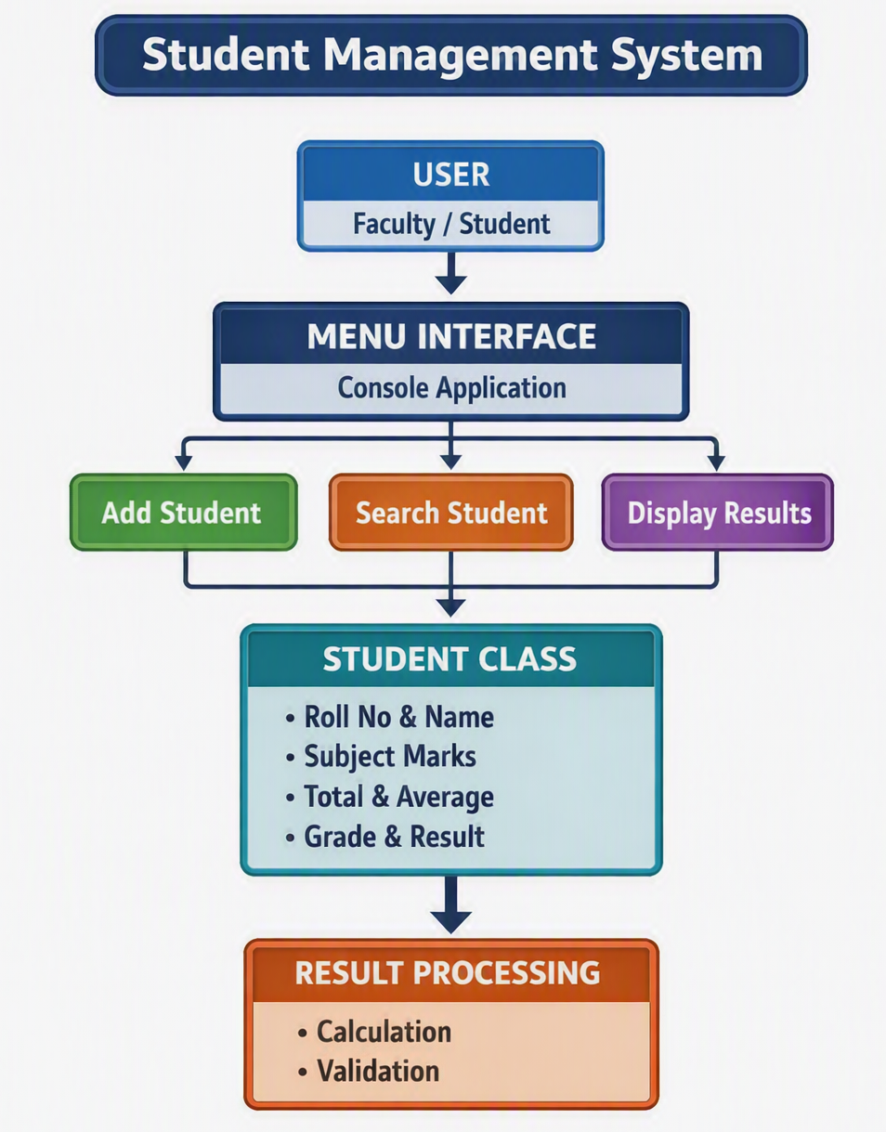
Architecture Diagram

Slide 9
ER Diagram / DFD
MANAGES
STUDENT
RESULTS
STUDENT_ID
SUBJECT MARKS
MENU OPTIONS
TOTAL
GRADE
ROLL_NO
NAME
1.ADD STUDENTS
PERCENTAGE
AVERAGE
2.DISPLAY STUDENTS
STATUS
PASS/FAIL)
3.SEARCH STUDENTS
4.DISPLAY TOPPER(S)
1
5.DISPLAY FAILED STUDENTS
6.EXIT

Slide 10
Planning and Timeline Diagram
W1
W2
W3
W4
W5
Requirement Analysis
System Design (Class/ER Diagrams)
Coding & Module Development
Integration & Testing
Documentation & Final Review

Slide 11
Role of Each Individual
Roll No. | Name | Role / Responsibility
25B11AI908 | PASUPULETI SAI | Project planning, coding, integration, testing and team coordination
25B11AI745 | MANNEPALLY MARUTHI NAGA SAI SRINIVAS | Requirement analysis and testing
25B11AIC03 | THOTAKURI REVANTH | Flowchart, diagrams and documentation
26B21AI099 | PASUPULETI VENKATA SURYA HARSHA | PPT preparation, output verification and presentation

Slide 12


